Slide 1



welcome!
Mick Girdwood & Prasanna Sritharan
25 May 2022

Slide 2

Dr Prasanna Sritharan
Postdoctoral Research Fellow
La Trobe Sports & Exercise Medicine Research Centre
p.sritharan@latrobe.edu.au
Research interests:
Musculoskeletal modelling, biomechanical simulation
I use R for:
Data analysis, wrangling, visualisation

Slide 3
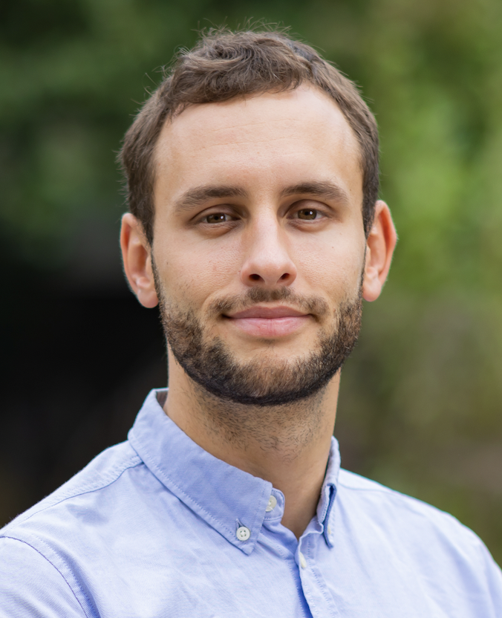
Mick Girdwood
PhD Student / Physiotherapist
La Trobe Sports & Exercise Medicine Research Centre
m.girdwood@Latrobe.edu
Research interests:
Muscle strength and cortical processes in MSK injuries
I use R for:
Data management, wrangling, analysis and visualisation

Slide 4

Scenario:
Gait Experiments

Slide 5
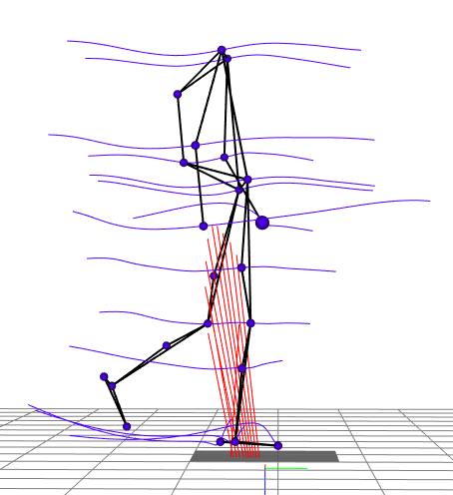


Experimental data
SUBJECT 1
SUBJECT 2
50 participants
25 symptomatic, 25 control
10 trials per participant
500 trials total
(250 trials per group)
20 measured temporal
variables per trial + time
Each trial duration is different
10 CSV files per participant
21 data columns per file
+ 1 Excel spreadsheet
with participant info
(group, age, mass, sex, etc)

Slide 6

Your mission
*
Calculate descriptives for each variable
(mean, variance, etc)
Perform inferential testing on each variable
(t-tests, F-test, ANOVA, SPM{?}, etc)
Generate plots of the mean of
each temporal variable with
±1 std dev shaded
Indicate regions of significance

Slide 7
Workflow

Slide 8

Objectives
Friendly and regular meet up to help share the joy of R and other coding methods, between researchers and students
Get to know you
Your background in R and other software
Share things you would like to know more about to tailor future content

Slide 9
Objectives
We want this to be a place to share ideas, methods, to help improve everyone’s skills with data, communication and efficiencies.
We also invite everyone from different backgrounds and departments to join too! – Please invite anyone you think could be interested!

Slide 10

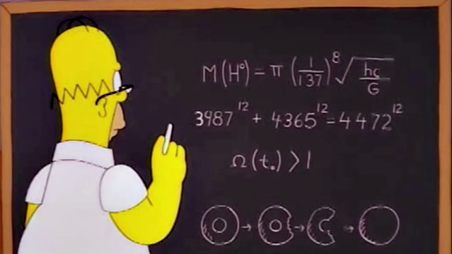


Share our experiences with new packages
Workshops to help develop coding skills
Regular drop-in sessions for coding help
Initiate new collaborations
and explore new ideas and methods

Slide 11

Why learn/apply scripting for your research?
Lifelong skill, improves problem solving through structural thinking
Flexibility, the language isn’t important, it’s the thinking – languages are the easy part
Enables abstraction, reusability, efficiency, and minimises errors
Competitive advantage, scripting is not domain-specific, take it with you to your next job
Develop an in-depth understanding of what your are doing and why

Slide 12
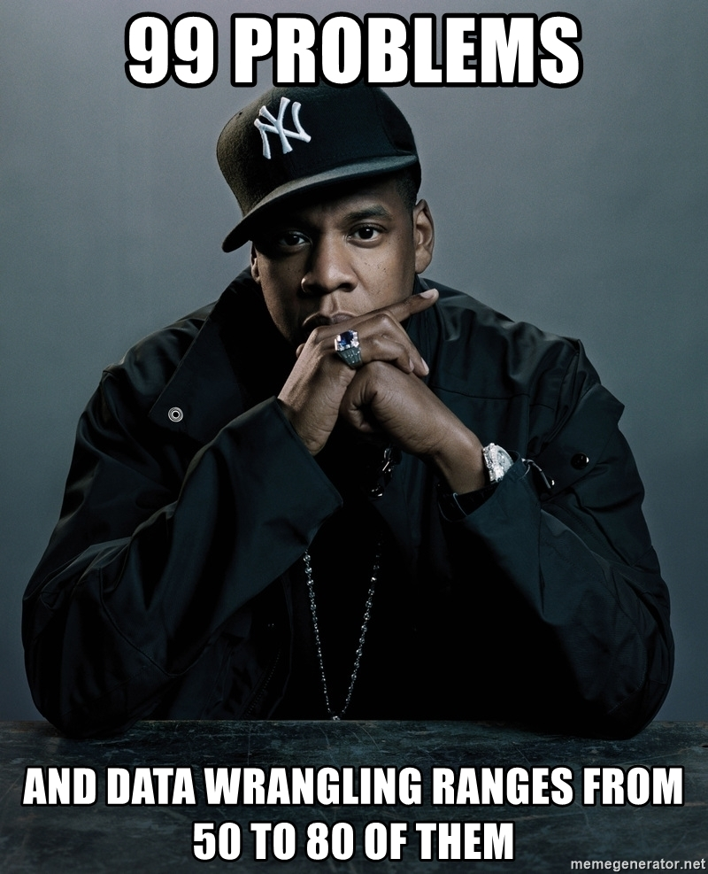
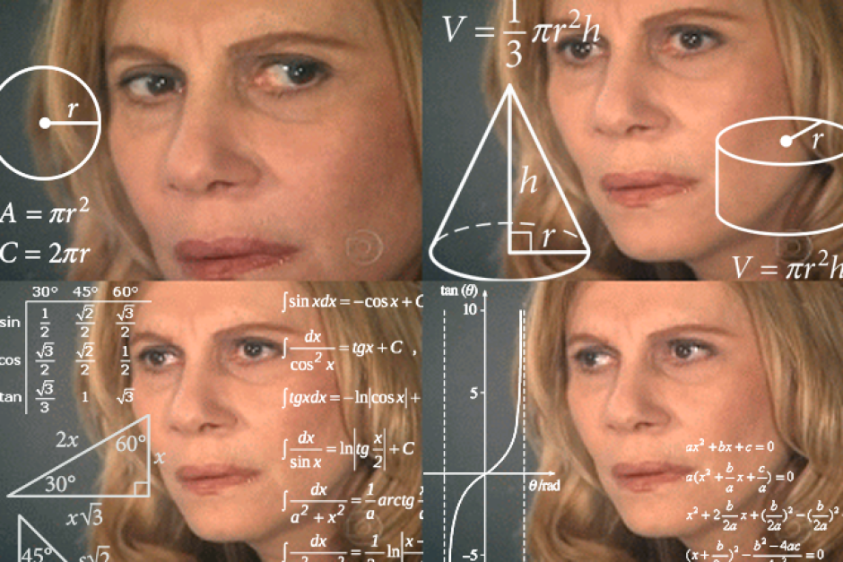
What could you do with R? – The obvious
The obvious:
Data Wrangling
Data analysis
Statistical testing

Slide 13
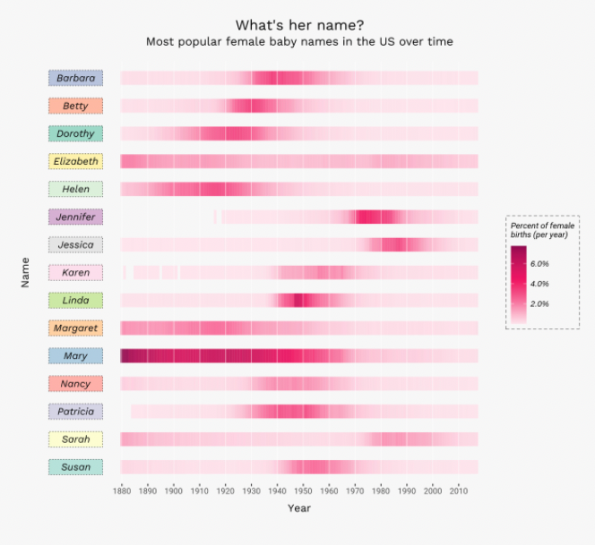
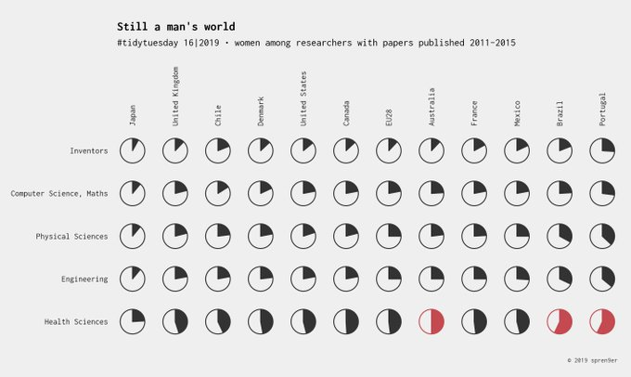
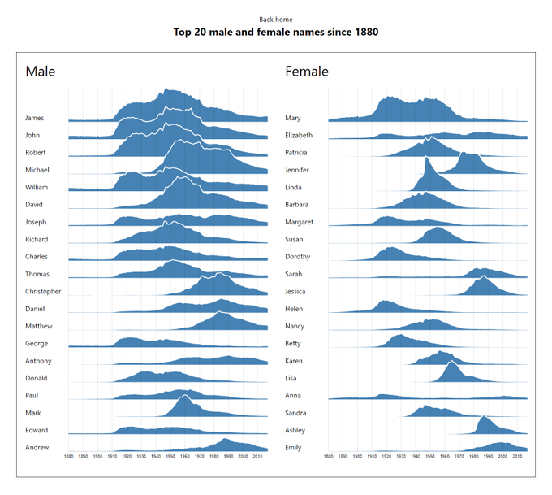
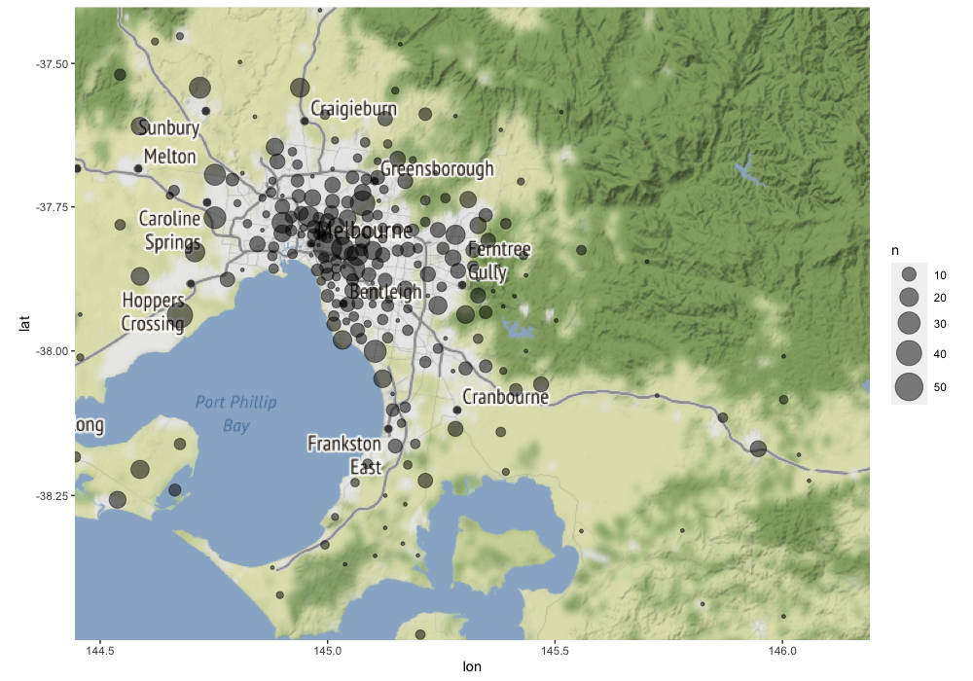
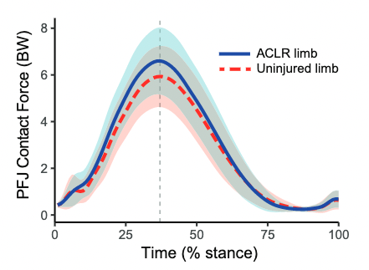
What could you do with R? – The obvious
Data Visualisation and Plots

Slide 14
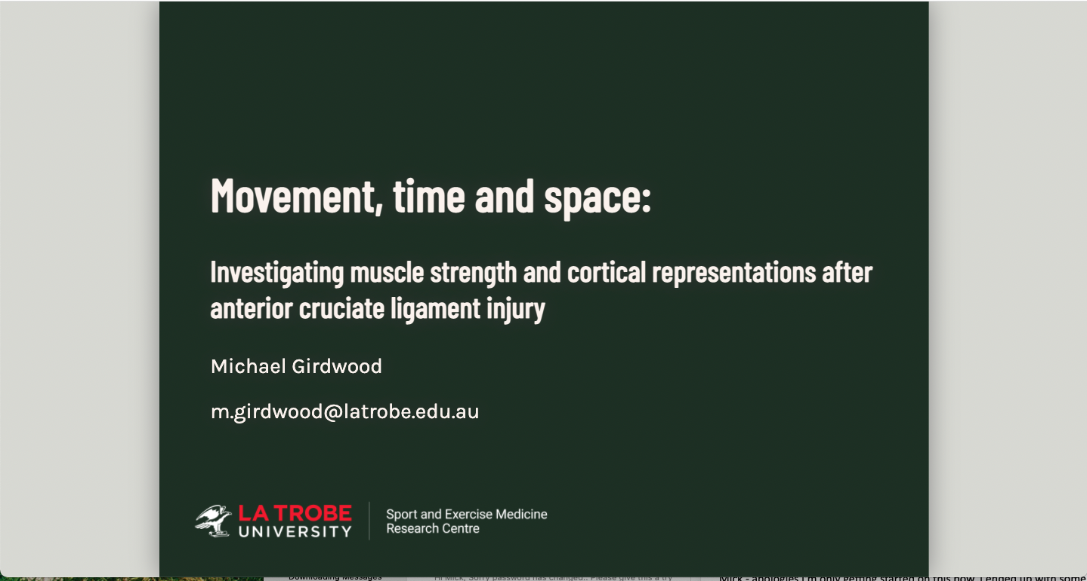
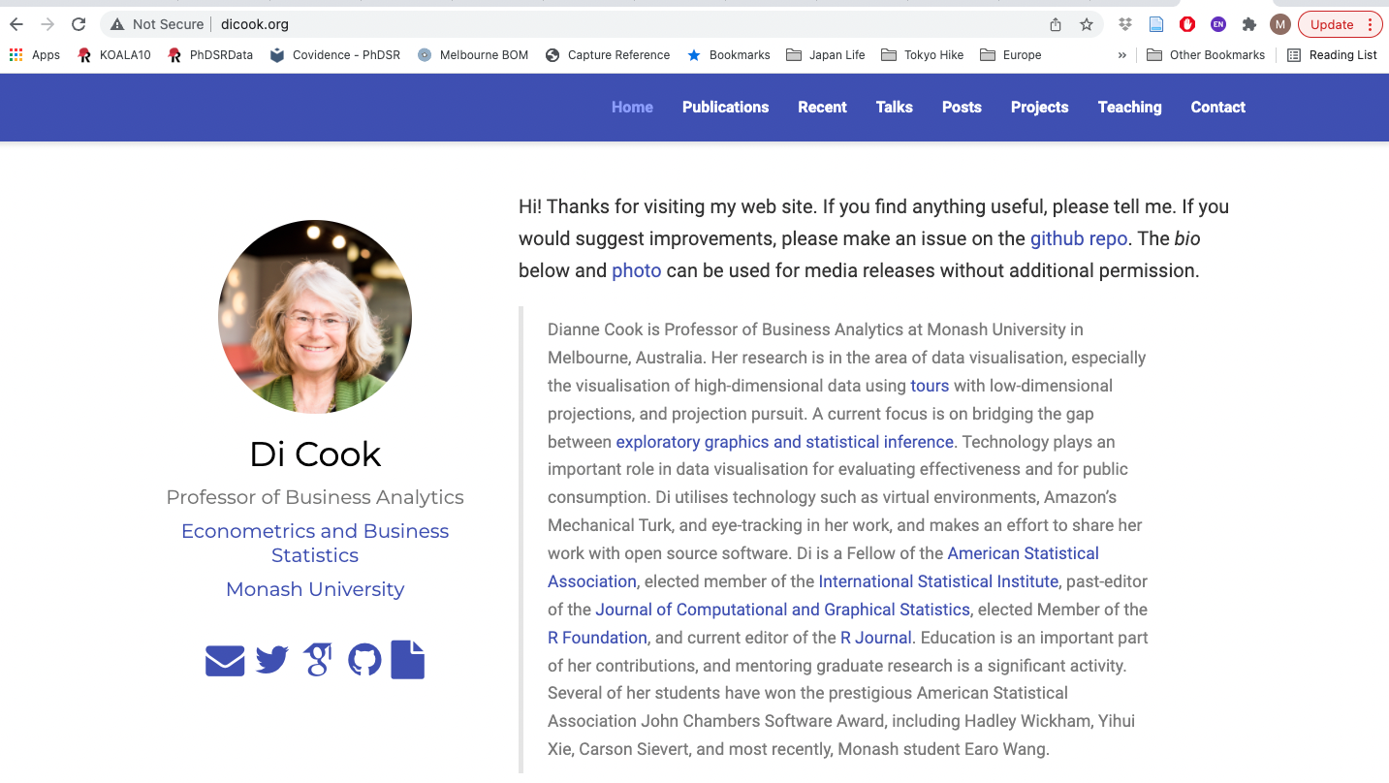
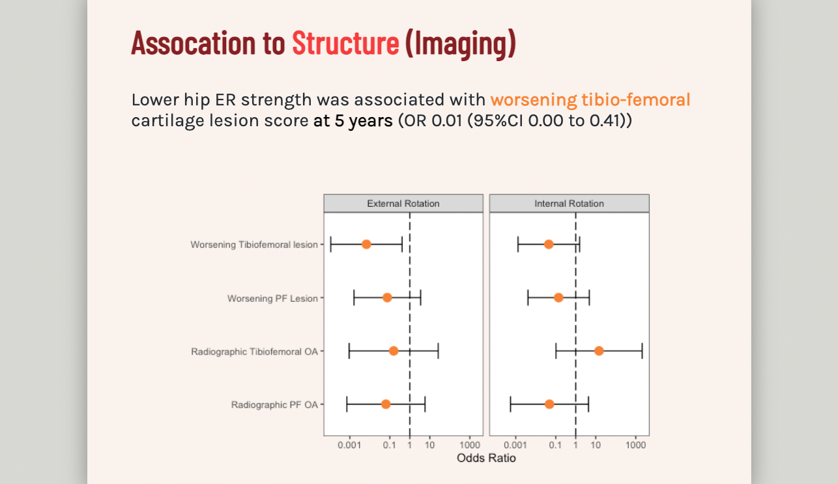
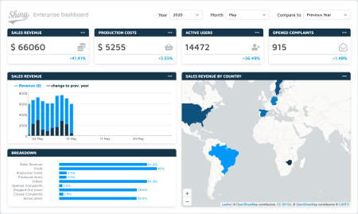
What could you do with R? – The less obvious
Presentations/Slides
Websites / Dashboards / Apps

Slide 15
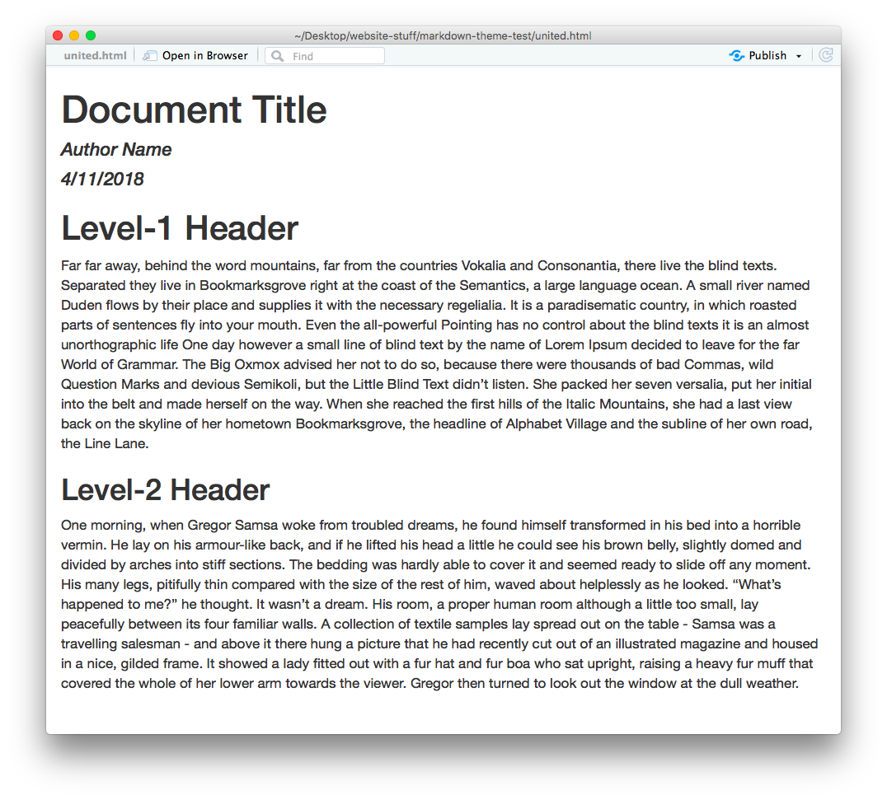

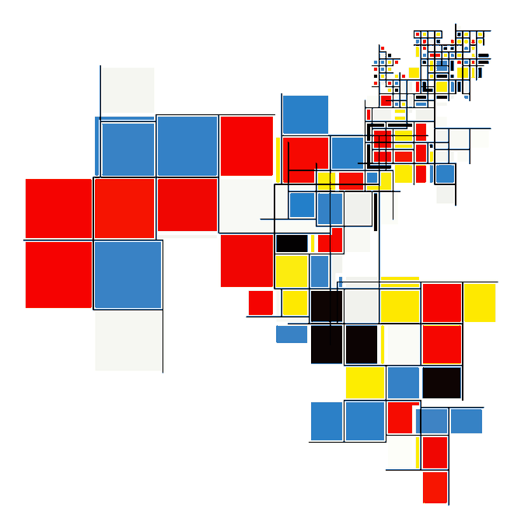


What could you do with R? – The less obvious
Documents / Reports
Art!

Slide 16

What could you do with R? – The ethical
Reproducibility / Open Science

Slide 17
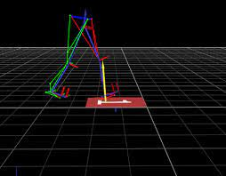
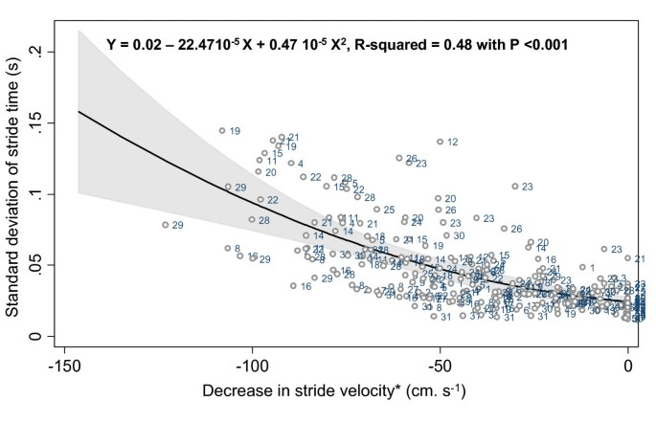
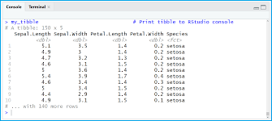
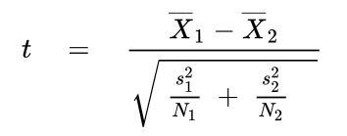
How can coding improve your work?
Acquire data
Prepare data
Modelling &
Analysis
Report/
Visualise
Experiment
Simulation
Interview/survey
Observation
Records
Etc…
Extract specific data points
Reshape data
Fix errors
Fill missing data
Descriptives
Tests of difference
Correlation
Regression
Pattern recognition
Etc…
Figures
Tables
Reports
Etc…

Slide 18
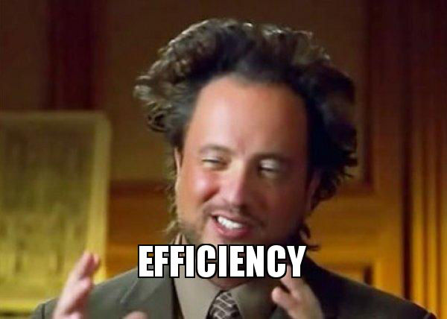
How can coding improve your work?

Slide 19
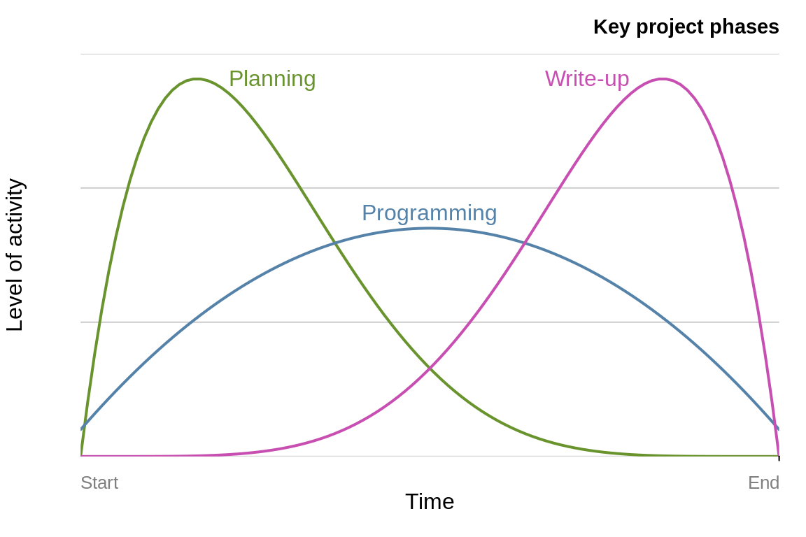
Programming ≠ statistics

Slide 20
OVER TO YOU!

Slide 21
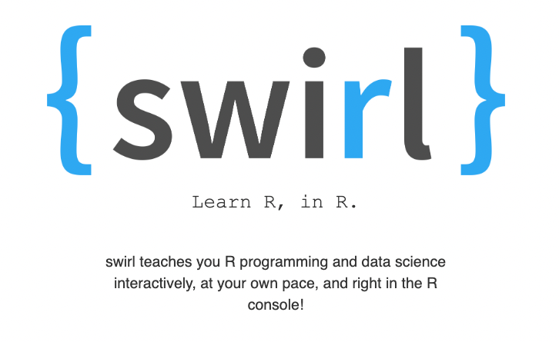
Resources
https://swirlstats.com/

Slide 22

Resources
https://r4ds.had.co.nz/index.html

Slide 23

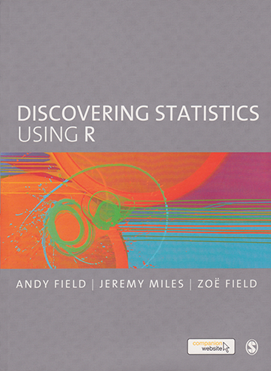
Resources
https://www.discoveringstatistics.com/books/discovering-stat
https://bookdown.org/ndphillips/YaRrr/

Slide 24

RESOURCES

Slide 25
BRING a problem to Solve!

